Slide 1


Electrical oven
Simulation of Operation using c

Slide 2


Project Components
INTRODUCTION
ADVANTAGES
CODE DESCRIPTION
FLOW CHART

Slide 3
:
Reasons behind choosing this project
We had an idea about how to make the program.
It’s an important application for safety.
A good example to show what we studied in our power department.
Saving time.
Flexing our knowledge because we are C professionals :D

Slide 4
What are the advantages of Our Oven simulator?
Until now, simulation users had to accept various trade-offs concerning resolution, process time and domain. Our oven simulation overcomes all these obstacles and disadvantages. We have the capability of depicting the whole industrial oven process at each moment in time. Further, discretization is significantly higher than ever before.

Slide 5
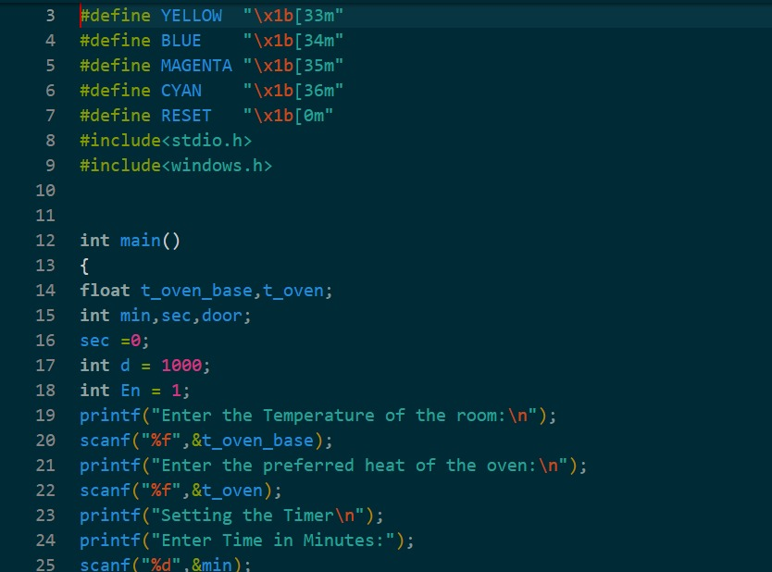
Code description : (part 1)
Declaring variables and asking the user for :
1)room temperature "Ambient Temp".
2)Oven heat.
3)Minutes of operation.

Slide 6
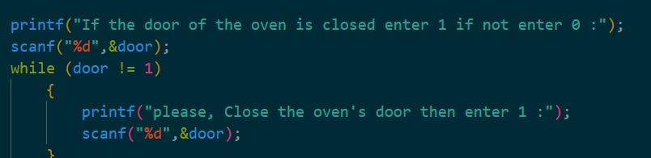
(part 2)
Checking the door in-close position

Slide 7
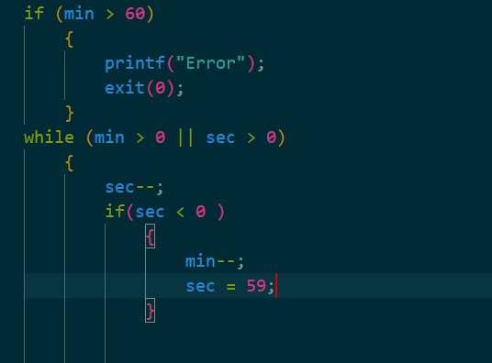
(PART 3)
Checking valid range of time 1 hour max- setting up the timer.
We're using an active high enable as a declaration of the oven activity.

Slide 8
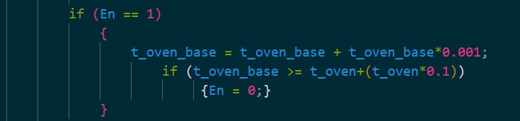
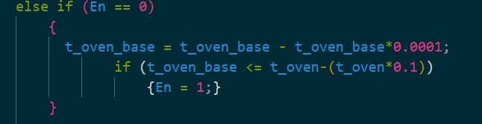
(PART 4)
We're using an active high enable as a declaration of the oven activity
If en = 0 it scales down to the lower limit then the en = 1 again

Slide 9
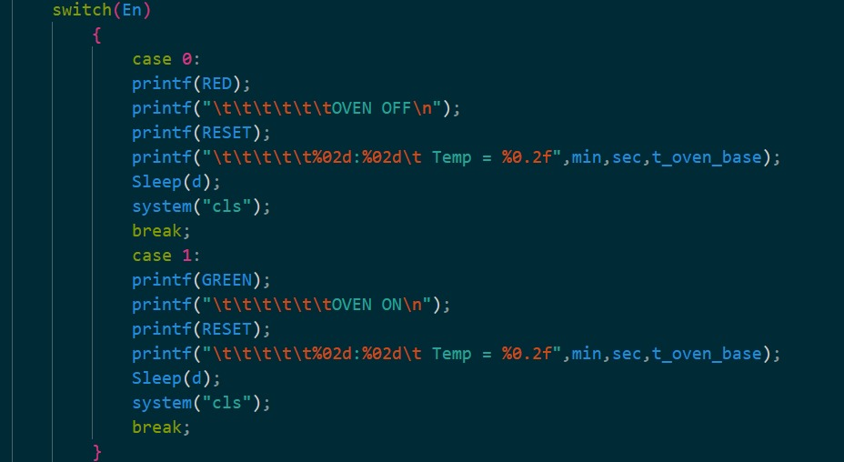
(PART 5)
This prints the clock and temp per second with oven on if en = 1 and oven off when en = 0

Slide 10
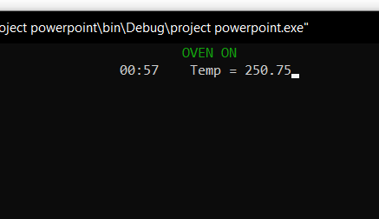
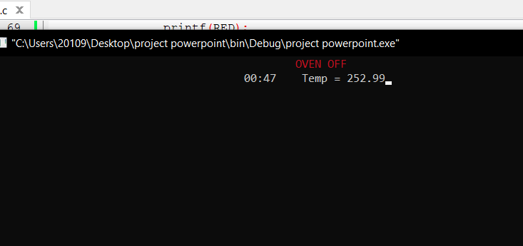
Execution samples
At room temperature 250
Preferred heat of oven 230
Operation time of 1 hour
Closed door

Slide 11
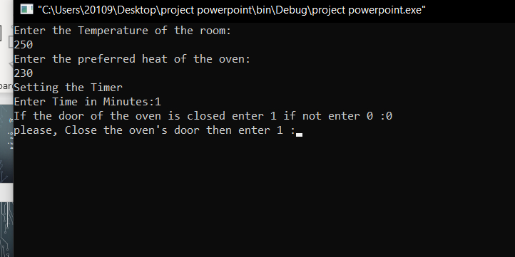
Execution samples
At room temperature 250
Preferred heat of oven 230
Operation time of 1 hour
Opened door

Slide 12

Execution samples
At room temperature 250
Preferred heat of oven 100
Operation time of 1 hour
Dish ready

Slide 13
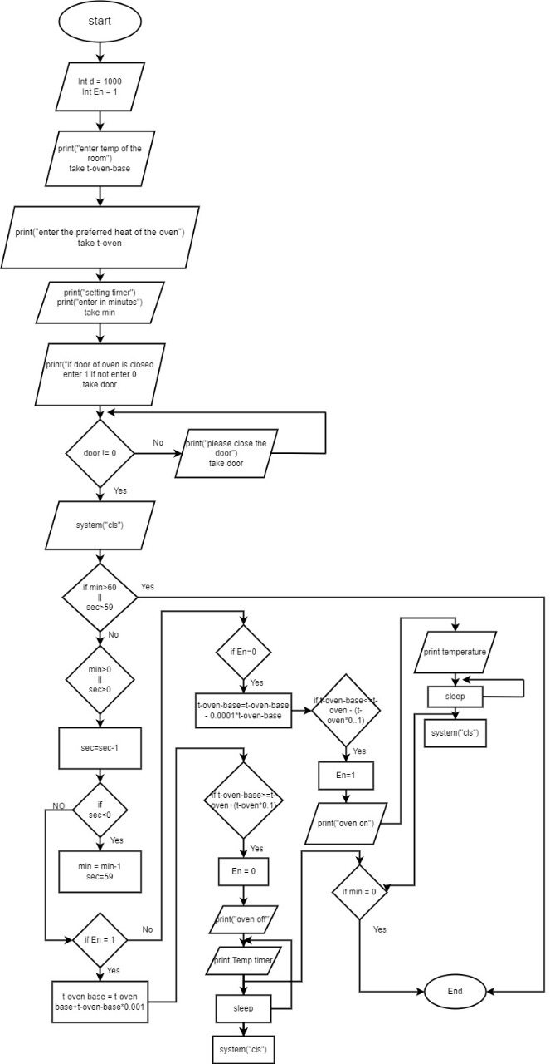
Flow chart representation
Main Flow chart

Slide 14
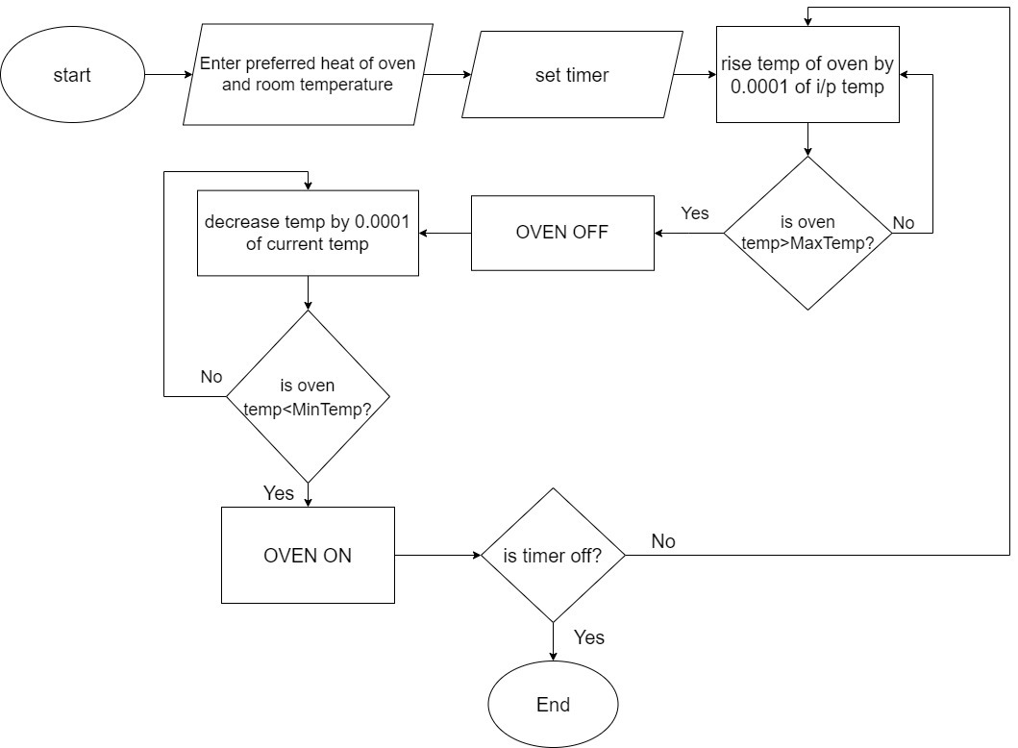

Slide 15
This project was made by
1)Mohaymen Abdel mageed Saleh
2)Marwan Magdy Attia
3)Ahmed Mounir Ali
4)Shrouk Abdel khalek Fatoh
5)Nouran Mostafa Mohamed
6)Ahmed Attallah Ahmed
7)Ahmed Mohamed Sayed Dawood
8)Omar Ayman Abdo Mohamed
9)Hossam Eldin Mohamed Hassan

Slide 16

Thanks for watching <3

